Slide 1
TIBCO BusinessEvents™ for Event-Driven Decisions
27 Nov 2008
Paul Vincent

Slide 2
Agenda
Agenda
Approaches to Rules & Decisions
The Event Decision Architecture
BusinessEvents capabilities

Slide 3
Key Business Rule based Business Requirements
Ability to apply rules in business processes
Define business risks based upon historical data
Apply profiling across the life of a transaction that can drive additional behavior and events at any stage during the business process
Apply additional interactive logic and behavior in customer interactions such as in CRM
Have a capability to cross-reference operational information against historic information for better decisions
Use a technology that supports existing IT investments such as BPM and SOA

Slide 4
Introduction
Business Goals
Business Strategy
Business Tactics
Business Policies
Business Rules
Business Events
Data Relationship Rules
Decision Rules
Data Constraint Rules
Historical Events / Data
Notes:
Business rules themselves are viewed as some as “actionable business statements” to enact policies that in turn are driven by business goals (see OMG Business Motivation Model). BR can describe simple facts (eg every customer has a delivery address) that map to concept/object models, as well as decision rules (eg if customer address is local then delivery process is local courier), defined usually in the context of some process.
Business processes are traditional orchestrated (see BPMN flows in BusinessStudio for iProcess) – usually where manual workflow tasks are required – and continuous CEP processes.
Note that BE can act in both (eg Enterprise edition for CEP, Inference edition for rule services under BPM)

Slide 5
Background on Business Decisions Process
Event Bus
Customer Events etc
Business Processes
Technology: BPM e.g. TIBCO iProcess
Database
Event Bus

Slide 6
Background on Business Decisions Process
Event Bus
Customer Events etc
Business Processes
Technology: BPM e.g. TIBCO iProcess
Database
Decision Engine
Technology: Rules Engine e.g. TIBCO BusinessEvents
Event Bus

Slide 7
Background on Business Decisions Process
Event Bus
Customer Events etc
Business Processes
Technology: BPM e.g. TIBCO iProcess
Database
Data Warehouse
Decision Engine
Technology: Rules Engine e.g. TIBCO BusinessEvents
Predictive Analytics Technology: Analytic Models
e.g. TIBCO Spotfire S+ e.g. SPSS
e.g. SAS
Event Bus
Dashboard / Reporting Technology: BI or BAM e.g. TIBCO Syndera e.g. SAP BusinessObjects
Business Experts Creating rules Interpreting Regulations Mapping tactics

Slide 8
Background on Business Rules and Decisions
Business Rule statements
Decision Models
Production Rules
Rules
Activities
Executable Code

Slide 9
Background on Rule Engines
Rule Engines
Most Rules are used to provide Decision Automation
Rule-Chaining Engines
Business Rule Engines
TIBCO iProcess Decisions
TIBCO BusinessEvents
Some Inference Engines are academic use only
Also allows non-inferencing rules eg ruleFns
Most commercial BREs do code generation, not inferencing, in normal use
Better thought of as a decision engine, not a rule engine

Slide 10
Real world: All Decisions are Event-Driven
Explicit, simple events
Credit Card application
Loan Request
Credit Increase Request
Derived, complex events
Consumer Fraud possibility
Merchant Fraud possibility
Third Party Fraud possibility
Employee Fraud possibility
Potential Customer Loss
Potential Customer for other product

Slide 11
Complex Decisions are Event Driven
Complex events require monitoring the simple events and decisions
Identify patterns
In real-time
The decisions share events, data
Credit Card application patterns → Consumer Fraud possibility
All about Situation Awareness: business monitoring and insight
So why keep the data in a separate system?
Traditional answer: too complex for IT to design and manage decisions and data models in the same system
Current solution: CEP technologies combining rules, events and real-time data stores

Slide 12

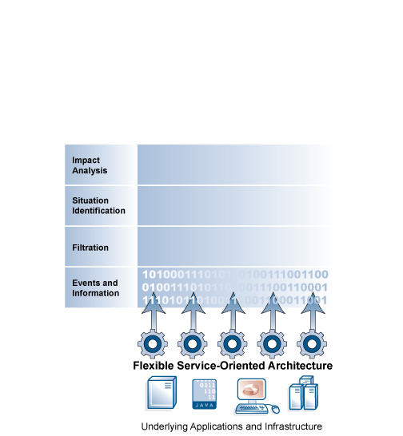
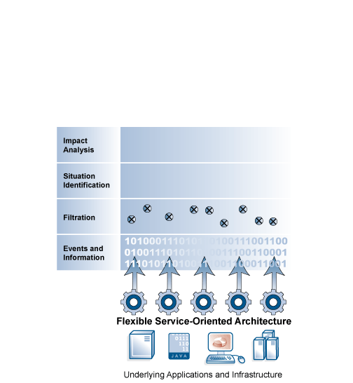
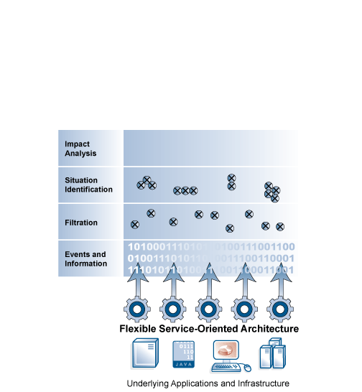
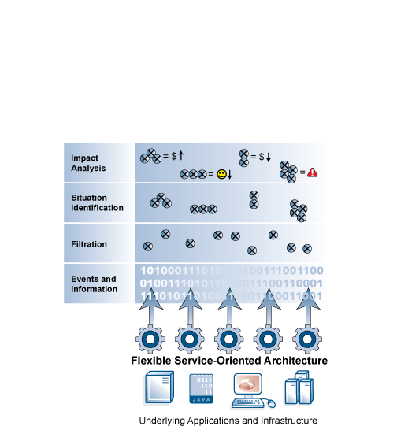
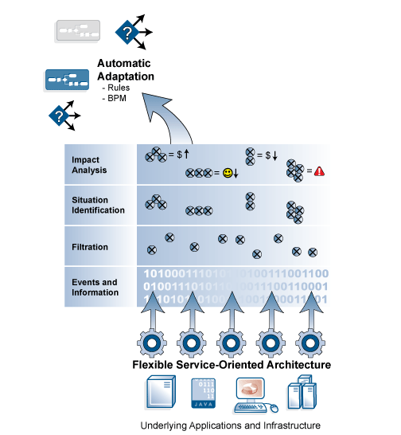
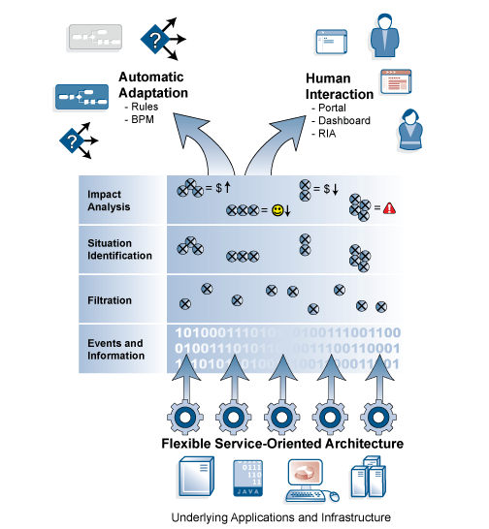
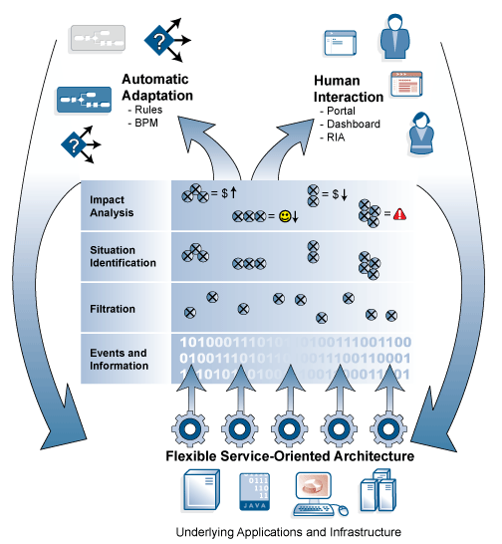
Needed: the Event-Decision Architecture (E-DA)
Flexible SOA and Event-Driven Architecture
Notes:
12

Slide 13
BusinessEvents – Rules Engine
At its core, BE is a Rules Inference Engine:
Receives events
Correlates events
Applies rules
Can generate internal events (which could trigger more rules)
Can send events out
Also includes
State Machine
Conceptual Model
Queries

Slide 14
Enhanced Business Decisions Process
Event Bus
Customer Events etc
Business Processes
Technology: BPM e.g. TIBCO iProcess
Database
Data Warehouse
Event Decision Engine
Technology: CEP+Rules Engine e.g. TIBCO BusinessEvents
Standard Process Rules + Rules from Decision Models + Rules Across Processes / Events
Predictive Analytics Technology: Analytic Models
e.g. TIBCO Spotfire S+ e.g. SPSS
e.g. SAS
Event Store
Event Bus
Dashboard / Reporting Technology: BI or BAM e.g. TIBCO Syndera e.g. SAP BusinessObjects
Business Experts Creating rules Interpreting Regulations Mapping tactics

Slide 15
TIBCO & Real-time Decisions
Decision Management
CEP Editors
Managed Entities
CEP Rule Agent
State Engine
State Model
CEP Query Agent
Inference Rule Engine
Query Engine
Rulebase
Query List
Distributed CEP Framework
Event Sources
Event Model
Class Model
Libraries
Event Sinks
Data Grid
Event Bus
Notes:
Dotted = roadmap

Slide 16
TIBCO & Real-time Decisions
Business Events drive business rule execution
Decision Management
Rule management & control using decision tables, decision workflow
CEP Editors
Managed Entities
CEP Rule Agent
Real-time rule engine using real-time event monitoring + storage, queries, statistical functions etc that can drive rule / score changes on-the-fly
State Engine
State Model
CEP Query Agent
Inference Rule Engine
Query Engine
Rulebase
Query List
Operational event store provides event warehouse for real-time historic pattern detection
IT-friendly model-driven engineering via easy-to-understand state, query, rules, concepts, …
Distributed CEP Framework
Event Sources
Event Model
Class Model
Libraries
Event Sinks
Champion Challenger thru multiple ruleset control / multiple decision agents
Data Grid
Event Bus
Notes:
Dotted = roadmap

Slide 17
TIBCO BusinessEvents in detail
TIBCO EMS, RV, BusinessWorks
Orchestration/ruleflow via BusinessWorks integration
Event Bus Low-latency reliable message delivery
Standard UML Class Model
Standard UML State Model for lifecycle of transaction components including monitoring rules and Operational Intelligence
Concept Model for mapping events to facts and data
TIBCO BusinessEvents
High performance (real-time optimized) inference engine with code-generation performance + inference capabilities
State Model for determining time-dependent info
Queries for set-based patterns
Rule Model for recognizing patterns, defining actions
OQL/SQL based queries that can be generated on the fly for manipulating data sets
High performance store for persistent transactions (eg portfolio views) and rule metadata updates
History and Cache
Notes:
Pros/cons vs ILOG and FIC
Integration: easier with TIBCO due to BW, and indeed historically this is a high-risk item for ILOG and FIC (ILOG used to have sever problems with proving integration); also FIC and ILOG need to specify some server eg WebSphere app server.
Concept model: easier with ILOG and FIC as they have a large range of built-in adapters to easily read-in a DB or XML schema. We have a DBConcept idea for BE3.0 but model sharing not high on the roadmap before Eclipse / BE4 / 09 (where we’ll re-use Eclipse capabilities here at design-time). ILOG/FIC POC could easily show profiles from DB2 as data in their rule engines.
State model: easier with BE; the other tools use a ruleflow. For AllState a ruleflow (mapping a transaction context) could be sold as easier to understand, but we could argue that a State Model is actually more powerful and adaptable to cover the same sorts of thing. Ruleflows are more akin to BE orchestrations though. They can include loops. But then, of course you can loop through a state model too.
Rule engine:
performance: this is probably a wash. For transactions like AllState, FIC and ILOG will quote to use code-generation (ie not a rule engine) which maps rules to Java code. A similar approach is used for BE rule functions. So FIC and ILOG will claim they are faster (as they generate Java code) but in fact we can do the same. The main difference here is they can take the same rule (actually ruleset) and flag it for inferencing or code generation, whereas we decide at design-time by using a rule fn or a rule. But the difference is slight.
expressions: this is where we fall down, with ILOG and FIC having much richer rule languages eg quantitative expressions, re-usable declarations across rules, inner joins. We counter this with queries in BE3 and that these features are not required for Phase 1. But this is definitely a weak-point for us. Other areas are things like constraint rules (FIC and ILOG can do event-condition-action rules for events like “data changed value”), and rule inheritance (re-using rule filters in other rules by referring to a rule name)
Rule mgmt: clearly we don’t compete today here. BE3 introduces some capabilities, but ILOG and FIC have 8 years experience in selling + many many yrs development behind their BUI + repository capabilities. Even if we piggy back on BPM developments in this area, we will have difficulty in matching these for a few yrs. However, we would certainly be competitive with someone like Pega.

Slide 18
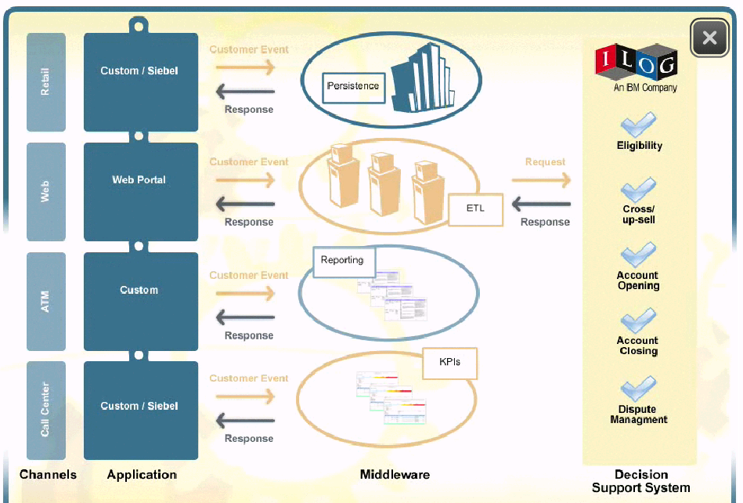
BE versus conventional BREs
Conventional BREs work as a predefined decision service for particular tasks
BE includes persistence
Graphic courtesy of IBM
BE handles decision services “tasks”
BE output events represent real-time reports
BE includes KPI handling and cross-service monitoring
Inter-service messages / latency reduced as services all in BE
Notes:
See http://www.nxtbook.com/nxtbooks/ilog/extendingcrmwp/#/7/OnePage

Slide 20
APPENDIX Technical Considerations for E-DA vs BRE
The following illustrate some of the advantages of Event-Decision Architecture vs Conventional Rule Engines

Slide 21
Business Control of Decisions
Event Bus
Event Sources
BPM / SOA
TIBCO BusinessEvents Event-Driven Rules Engine
Event Consumers
State Engine
State Model
Inference Rule Engine
Rulebase
Streaming Query Engine
Queries
Event Bus / Store
Dashboard
Decision Manager
Graphical Reports
CEP Editors
BI & Analytics
Statistical Pattern Detection
Graphical Pattern Detection
Notes:
BI = Spotfire
Tools like constraint-based optimization (maximize load, pricing etc per some complex set of events)
Real time visualization eg AJAX (GI) dashboards, SL Corp fat client, …
ML is an increasingly interesting topic
Higher performance implies need for parallel / distributed agents sharing data eg Tangosol

Slide 22
SOA vs EDA approaches to Decision Services
SOA approach
EDA approach
Define Business Event
Define Business Event
Define App Server / web service
Define associated Rule
Define Decision Event
Define Service / Ruleset orchestation
Design and development time / cost
Define associated Rule
Define Decision Result

Slide 23
Shared Data vs Managed Events in Decision Services
Business Event
Business Event
Service Invoker Process
Event-driven Business Rule / Decision Engine
Data Retrieve Process
Data Grid Access
Business Rule / Decision Engine
Decision Result
Decision Result
runtime
Data Store Process

Slide 24
Decision Logic for Analytic-based Decisions
Business Event
Business Event
Decision Service invoker
Event-driven Business Rule / Decision Engine
Data Retrieve Process
Data Grid Access
Analytics Rule
Business Rule / Decision Service
Rule Change
runtime
Data Warehouse
Analytics Task
Rule Change
Notes:
Real-time operations analytics deducing rule changes on the fly

Slide 25
Decision Logic for Analytic-based Decisions (2)
Business Event
Business Event
Decision Service invoker
Event-driven Business Rule / Decision Engine
Data Retrieve Process
Data Grid Access
Business Rule / Decision Service
Spotfire S+ Analytics on event batches
runtime
Data Warehouse
Rule Change
Analytics Task
Rule Change
Notes:
Use of S+ against the event store is proposed

Slide 26
Decision Logic for Analytic-based Decisions (3)
Business Event
Business Event
Decision Service invoker
Event-driven Business Rule / Decision Engine
Data Retrieve Process
Data Grid Access
Business Rule / Decision Service
runtime
Data Warehouse
Data Warehouse
Analytics Task
Spotfire/SAS/SPSS etc Analytics Task
Rule Change
Rule Change
Notes:
BE can also operate with the traditional SAS / SPSS / S+ mode of operations

Slide 27
Multiple Decision Strategies
Business Event
Business Event
Service Invoker Process
Multiple Decision Strategies in parallel
Result Comparisons in-situ
Champion Decision Strategy
Challenger Decision Strategy
Strategy Decision
Result Comparison Decisions
Strategy Decision
runtime

